Slide 1



UNIVERSITY INSTITUTE OF ENGINEERING
COMPUTER SCIENCE ENGINEERING
Bachelor of Engineering
Theory of Computation (CST-353)
Topic: Introduction
DISCOVER . LEARN . EMPOWER

Slide 2
Learning Objectives & Outcomes
Objective:
To understand the basics to automata.
Outcome:
Student will understand the
  Basics of automata

Slide 3
What is Automata Theory?
Study of abstract computing devices, or “machines”
Automaton = an abstract computing device
A fundamental question in computer science:
  Find out what different models of machines can do and cannot do
  The theory of computation
Computability vs. Complexity
Notes:
Cpt S 317: Spring 2009
School of EECS, WSU

Slide 4
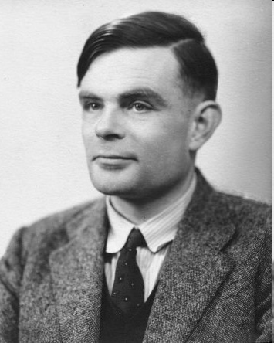
(A pioneer of automata theory)
Alan Turing (1912-1954)
Father of Modern Computer Science
English mathematician
Studied abstract machines called Turing machines even before computers existed
Heard of the Turing test?
Notes:
Cpt S 317: Spring 2009
School of EECS, WSU

Slide 5
Theory of Computation: A Historical Perspective
1930s
Alan Turing studies Turing machines
Decidability
Halting problem
1940-1950s
“Finite automata” machines studied
Noam Chomsky proposes the
“Chomsky Hierarchy” for formal
languages
1969
Cook introduces “intractable” problems
or “NP-Hard” problems
Modern computer science: compilers,
computational & complexity theory evolve
1970-
Notes:
Cpt S 317: Spring 2009
School of EECS, WSU

Slide 6
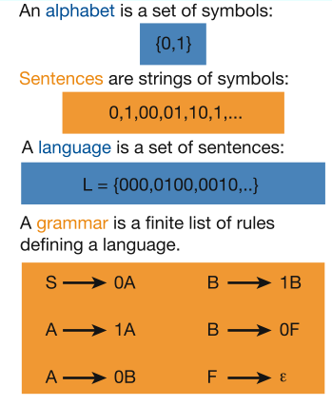
Languages & Grammars
Languages: “A language is a collection of sentences of finite length all constructed from a finite alphabet of symbols”
Grammars: “A grammar can be regarded as a device that enumerates the sentences of a language” - nothing more, nothing less
N. Chomsky, Information and Control, Vol 2, 1959
Or “words”
Image source: Nowak et al. Nature, vol 417, 2002
Notes:
Cpt S 317: Spring 2009
School of EECS, WSU

Slide 7
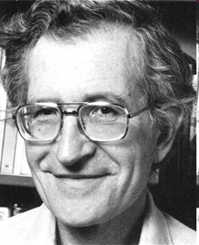
The Chomsky Hierachy
A containment hierarchy of classes of formal languages
Recursively-
enumerable
(TM)
Context-
sensitive
(LBA)
Context-
free
(PDA)
Regular
(DFA)
Notes:
Cpt S 317: Spring 2009
School of EECS, WSU

Slide 8
Finite Automata
Finite automata are used to recognize patterns.
2. It takes the string of symbol as input and changes its state accordingly. When the desired symbol is found, then the transition occurs.
3. At the time of transition, the automata can either move to the next state or stay in the same state.
4. Finite automata have two states, Accept state or Reject state. When the input string is processed successfully, and the automata reached its final state, then it will accept.

Slide 9
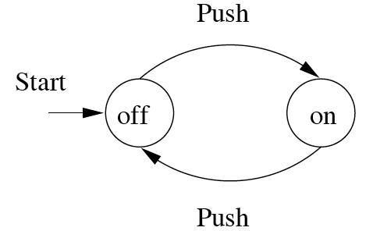
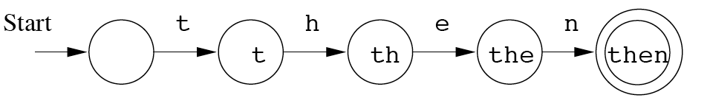
Finite Automata : Examples
On/Off switch
Modeling recognition of the word “then”
action
state
Start state
Transition
Intermediate
state
Final state
Notes:
Cpt S 317: Spring 2009
School of EECS, WSU

Slide 10
Formal Definition of FA
A finite automaton is a collection of 5-tuple (Q, ∑, δ, q0, F), where:
Q: finite set of states
∑: finite set of the input symbol
q0: initial state
F: final state
δ: Transition function

Slide 11
Finite Automata Model:
Finite automata can be represented by input tape and finite control.
Input tape: It is a linear tape having some number of cells. Each input symbol is placed in each cell.
Finite control: The finite control decides the next state on receiving particular input from input tape. The tape reader reads the cells one by one from left to right, and at a time only one input symbol is read.

Slide 12
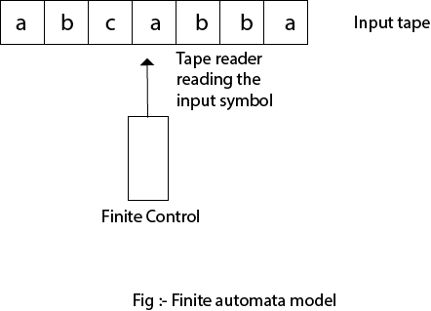

Slide 13
Types of Automata:
There are two types of finite automata:
DFA(deterministic finite automata)
NFA(non-deterministic finite automata)

Slide 14
Some important points about DFA and NFA:
Every DFA is NFA, but NFA is not DFA.
There can be multiple final states in both NFA and DFA.
DFA is used in Lexical Analysis in Compiler.
NFA is more of a theoretical concept.

Slide 15
Alphabet
An alphabet is a finite, non-empty set of symbols
We use the symbol ∑ (sigma) to denote an alphabet
Examples:
  Binary: ∑ = {0,1}
  All lower case letters: ∑ = {a,b,c,..z}
  Alphanumeric: ∑ = {a-z, A-Z, 0-9}
  DNA molecule letters: ∑ = {a,c,g,t}
  …
Notes:
Cpt S 317: Spring 2009
School of EECS, WSU

Slide 16
Powers of an alphabet
  Let ∑ be an alphabet.
  ∑^{k} = the set of all strings of length k
  ∑* = ∑⁰ U ∑¹ U ∑² U …
  ∑⁺ = ∑¹ U ∑² U ∑³ U …
Notes:
Cpt S 317: Spring 2009
School of EECS, WSU

Slide 17
Strings
A string or word is a finite sequence of symbols chosen from ∑
Empty string is ε (or “epsilon”)
Length of a string w, denoted by “|w|”, is equal to the number of (non- ε) characters in the string
  E.g., x = 010100 |x| = 6
  x = 01 ε 0 ε 1 ε 00 ε |x| = ?
  xy = concatentation of two strings x and y
Notes:
Cpt S 317: Spring 2009
School of EECS, WSU

Slide 18
Summary
Automata theory & a historical perspective
Chomsky hierarchy
Finite automata
Notes:
Cpt S 317: Spring 2009
School of EECS, WSU

Slide 19
FAQ :
What are types of finite automata.
2. Explain model of finite automata.
3. Explain tuples of finite automata.

Slide 20
References :
Martin J.C., “Introduction to Languages and Theory of Computation”, Tata McGraw-Hill Publising Company Limited, 3rd Edition.
https://youtu.be/S3cOulqSAmU
Https://en.wikipedia.org/wiki/Finite-state_machine
https://www.safaribooksonline.com
https://nptel.ac.in/courses/106/103/106103070/

Slide 21
THANK YOU

